Slide 1

Predicting Hypertension R
A Data-Driven Approach to Preventative Care Leveraging Machine Learning for Early Patient Intervention

Slide 2

The Business & Medical Problem
Goal
Identify patients at risk of hypertension before severe complications occur
Dataset
4,999 patient records
Focus on cardiovascular risk prediction
Challenge: Class Imbalance
92% Non-Hypertensive
8% Hypertensive

Slide 3


Which of the following is NOT a part of data preparation?
Handled missing values Standardized measurements Encoded categorical variables Dropped variables
Correct answer: D

Slide 4

Data Preparation & Data Leakage
Data Preparation
Handled missing values
Standardized measurements
Encoded categorical variables
Data Leakage Prevention - Dropped Variables
Systolic Blood Pressure (SBP)
Diastolic Blood Pressure (DBP)
Why? These variables directly define hypertension and artificially inflate performance

Slide 5
What does SMOTE stand for in the context of data imbalance?
Synthetic Mean Over-sampling Technique Synthetic Minority Over-sampling Technique Simple Minority Over-sampling Technique Statistical Minority Over-sampling Technique
Correct answer: B

Slide 6

Solving the Imbalance (SMOTE)
Problem
Model is biased toward the 92% majority class
Solution: SMOTE
Synthetic Minority Over-sampling Technique
How SMOTE Works
Generates synthetic minority-class observations
Balances training data
Improves model learning
Golden Rule
✅ Applied only to training data
❌ Never applied to testing data

Slide 7
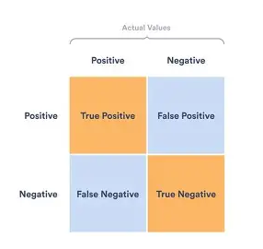
Choosing the Right Scorecard (Metrics)
Why Accuracy is Misleading
A model predicting 'No Hypertension' for everyone achieves ~92% accuracy
Evaluation Metrics
Recall: Ability to identify actual hypertensive patients
Precision: Proportion of predicted positives that are truly positive
F1-Score: Balance between Recall and Precision
ROC-AUC: Overall discriminatory power

Slide 8
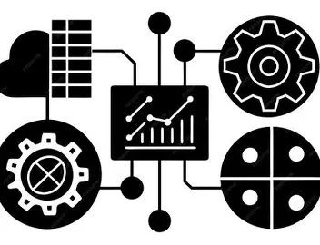
Model Competition
Algorithms Evaluated
Logistic Regression
K-Nearest Neighbors (KNN)
Support Vector Machine (SVM)
Naïve Bayes
Decision Tree
Random Forest
XGBoost
Model Categories
Linear: Logistic Regression
Tree-Based: Decision Tree, Random Forest, XGBoost
Distance-Based: KNN
Margin-Based: SVM

Slide 9

Proving Reliability (Cross-Validation)
Challenge
Avoid overfitting and ensure model generalization
Solution: 5-Fold Cross-Validation
Split data into 5 folds
Train on 4 folds, test on remaining fold
Repeat 5 times and average performance
Benefits
More reliable performance estimates
Reduced overfitting risk
Better model robustness

Slide 10

What Drives Hypertension? (Feature Importance)
Age
Increased arterial stiffness and higher cardiovascular risk
BMI
Increased blood volume and greater cardiac workload
Hemoglobin
Oxygen transport dynamics and cardiovascular stress indicators
HIV-Related Clinical Factors
Chronic inflammation and long-term treatment effects

Slide 11

The Winning Models
XGBoost
ROC-AUC ≈ 0.96
Highest overall performance
KNN Model
ROC-AUC ≈ 0.95
Random Forest
ROC-AUC ≈ 0.93
Strong predictive accuracy
Why Ensemble Learning Performs Best
Random Forest: Hundreds of decision trees with majority voting
XGBoost: Sequential learning that corrects previous errors with optimized boosting
0.9545
0.9545

Slide 12
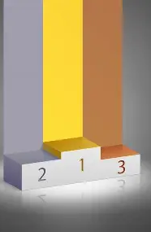
Results Summary
Model Performance (ROC-AUC)
XGBoost: 0.957
KNN: 0.953
Random Forest: 0.927
SVM: 0.880
Decision Tree: 0.770
Logistic Regression: 0.721
Naïve Bayes: 0.717
Key Finding
XGBoost achieved the strongest discrimination between hypertensive and non-hypertensive patients

Slide 13

Clinical Impact
From Prediction to Prevention
Benefits
✅ Early identification of high-risk patients
✅ Targeted monitoring and follow-up
✅ Better allocation of healthcare resources
✅ Reduced cardiovascular complications
Potential Outcomes
Earlier diagnosis
Lifestyle interventions
Timely medication initiation
Improved patient outcomes

Slide 14
Conclusion & Future Directions
Key Achievements
Developed robust ML framework for hypertension risk prediction
Successfully addressed class imbalance using SMOTE
Prevented data leakage through careful feature selection
XGBoost and Random Forest achieved excellent predictive performance
Future Directions
Integration into Electronic Health Record (EHR) systems
Real-time clinical decision support
External validation on independent populations
Expansion to other cardiovascular conditions
Final Impact
Shifting healthcare from reactive treatment to proactive prevention

